Slide 1
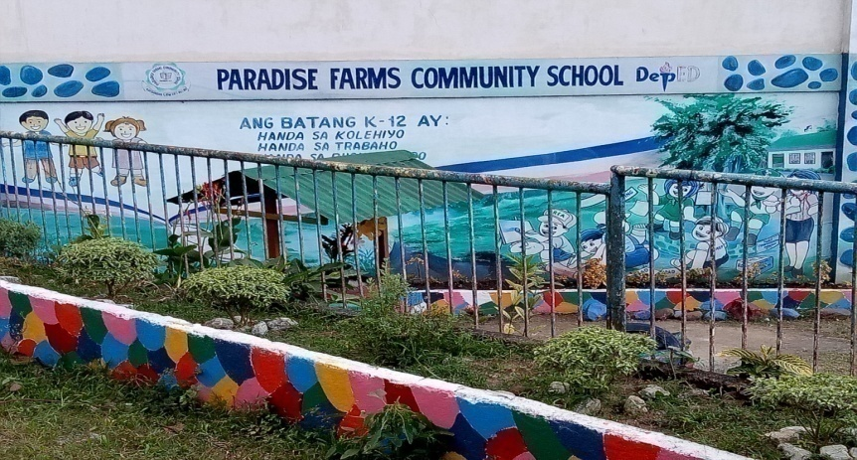
DEPARTMENT OF EDUCATION
REGION III
DIVISION OF CITY SCHOOLS
DITRSICT I
PARADISE FARMS COMMUNITY SCHOOL
SCHOOL REPORT CARD
2016-2017
LYN GRACE D. ABANADOR
Principal I

Slide 2
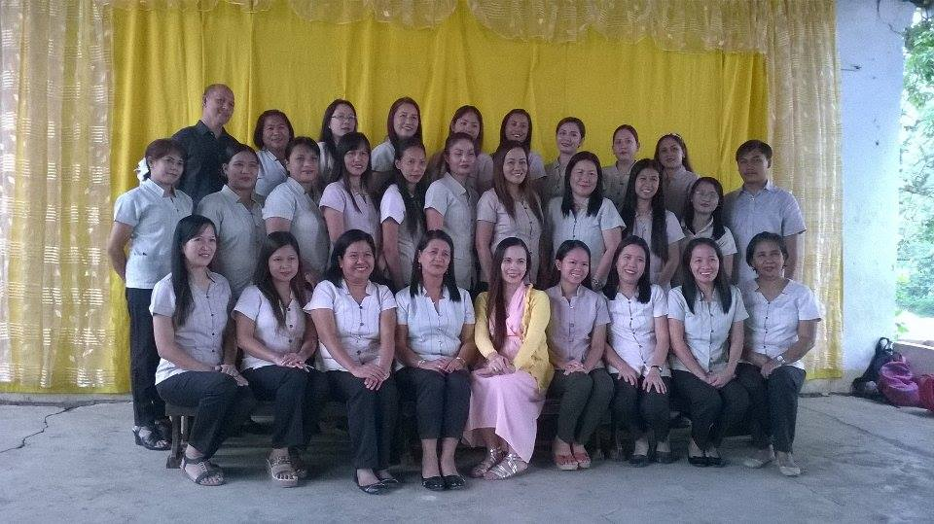
PFCS TEACHING FORCE
S.Y. 2016-2017
Kindergarten Grade IV
Olivia C. Dichoson Jane R. Andrade
Meriam V. Javier Visitacion M. Angala Sharmaine S. Tagle Lorena C. De Asis
Ma. Riella Cea E. Olea Grade I
Annabelle M. Curacha Grade V
Lucila T. Solomon Mary Jane A. Vasquez
Judyline T. Glee Mary Madeline B. Sy
Mary Jane L. Cortez
Grade II Cristine Joy Lucas
Zenaida P. Bautista
Editha C. Cajucom Grade VI
Jenevive R. Basilis Maricon P. Perez
Cherry May H. Domalaon Ma. Teresa O. Lamoste
Maricris T. So
Grade III Teresa C. Herrera
Arlene D. Fajardo
Gloria T. Bautista Subject Teachers
Marites V. Sabanal Arnold A. Dela Cruz
Emma Ruth T. Burgos Ria C. Palma
PFCS FACULTY
INTRODUCTION
PFCS aims to continuously provide a nurturing environment committed to achieving excellence. Headed by a wholehearted and enthusiastic principal, Mrs. Lyn Grace D. Abanador, close supervision to the school projects, implementation of new school policies for improvement and strengthening partnership with stakeholders, faculty members and parents ensure success of plans and projects for the benefit of our clientele, the PFCS pupils. The school believes in its battle cry: “Collaboration and cooperation towards growth and development.”
LYN GRACE D. ABANADOR
Principal I

Slide 3
SCHOOL GOVERNING COUNCIL
LYN GRACE D. ABANADOR
Team Leader
SOFIA LAURA BARCELONA ARNOLD A. DELA CRUZ
Student Representative Teacher Representative
ROMEO ANGUSTIA FRED H. MORANTE
Parent Representative Educ. Committee/LGU Representative
EVA Q. GADO DITHA C. CAJUCOM
Member of BORMMC Member of Child Protection Policy
ERIBERTO P. BELISANO JR. SONIA S. BOTICTIC
Brgy. Chairman/SGC Chairman Member, NGO
Approved:
GERMELINA H. PASCUAL, CESO V
Schools Division Superintendent
GENERAL PARENTS-TEACHERS ASSOCIATION
SY 2016 - 2017
TERESA C. HERRERA MA. THERESA MENDOZA JOCELYN ESPINOSA
BOD P.R.O . P.R.O.
EMILY VALENTON VICENTE LANUZA VICTORIA P. CASTILLO
Business Manager Auditor Treasurer
SONIA S. BOTICTIC JEANNE DEL CAMPO FREDERICK AGUILA
Secretary BOD BOD
JANE LLAMES JOY ALEGAR GLORIA T. BAUTISTA
Secretary BOD BOD
ARNOLD A. DELA CRUZ EVA Q. GADO ROMEO ANGUSTIA
BOD Vice President GPTA President
LYN GRACE D. ABANADOR
Tagapayo
I. SCHOOL PROFILE
A. ENROLLMENT
School Year 2016-2017 has a total enrolment of 1,201 consisting of 618 males, 583 females from Kinder to Grades Six.

Slide 4
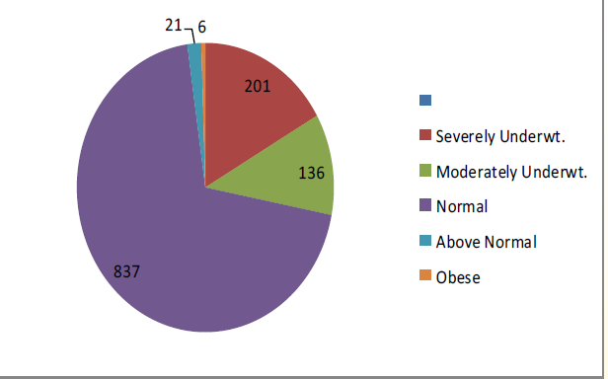
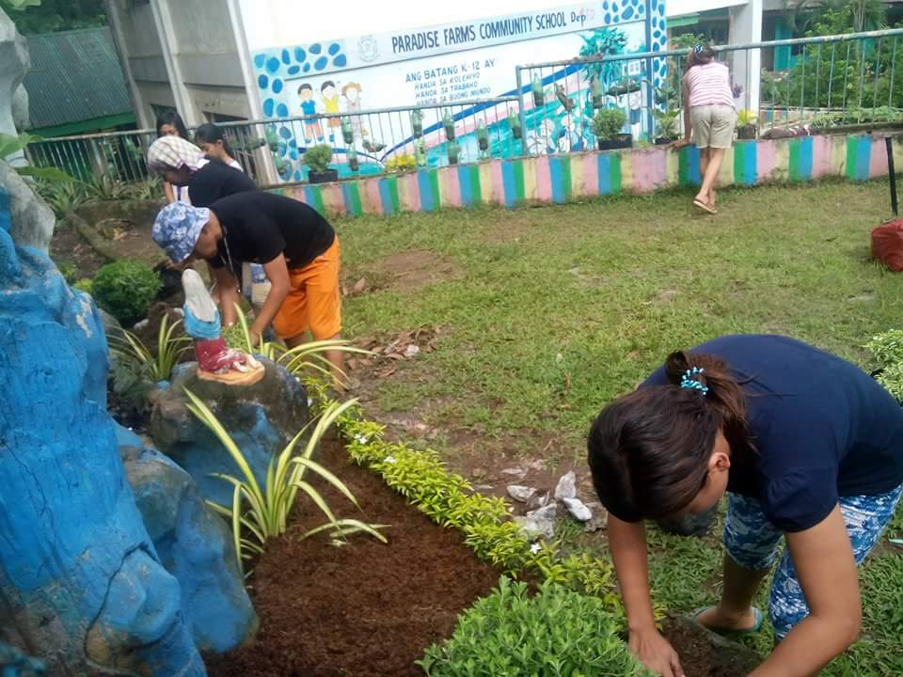
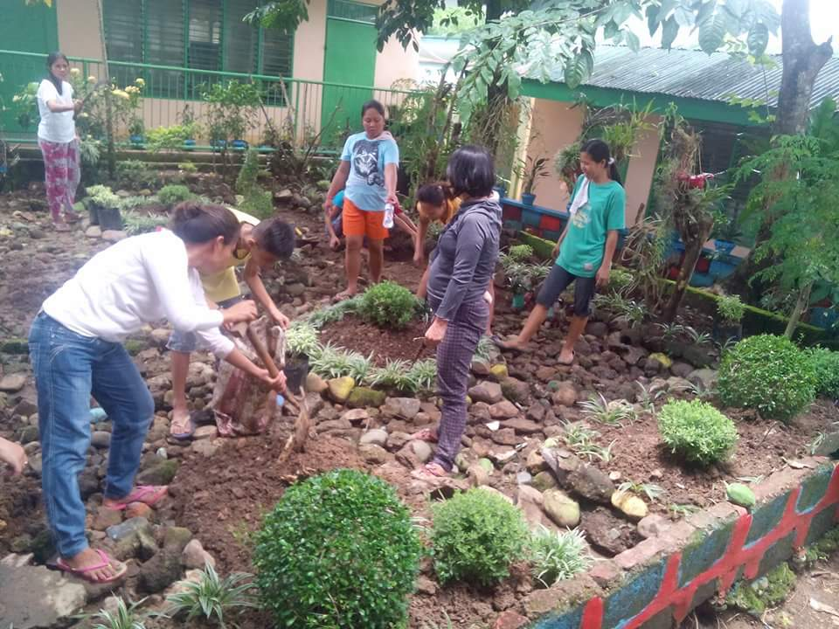
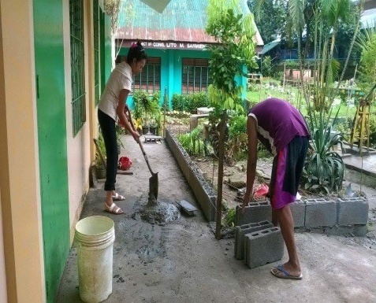
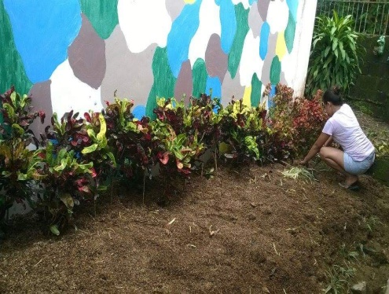
B. HEALTH AND NUTRITIONAL STATUS
B. OTHER STAKEHOLDERS’ ACCOMPLISHMENTS
201 severely wasted and moderately underweight pupils enjoying the 120 days school feeding program.
C. LEARNERS MATERIALS’
This figure shows that there is insufficient textbook for Grade V. However, there is enough textbooks from Grade I to VI utilized by the pupils.
1:1. The school library and LRMDS is functional.

Slide 5
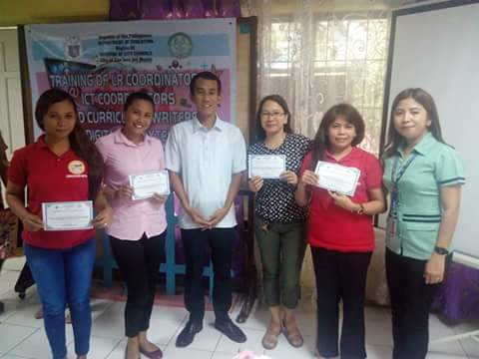
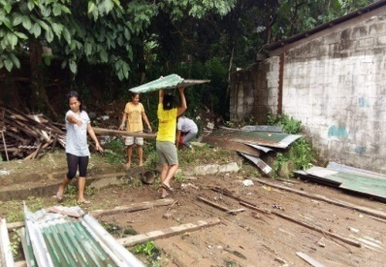
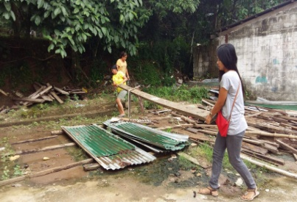
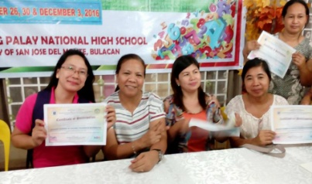
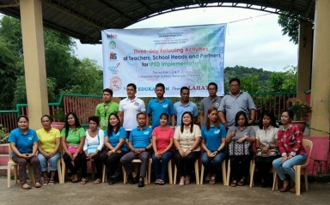
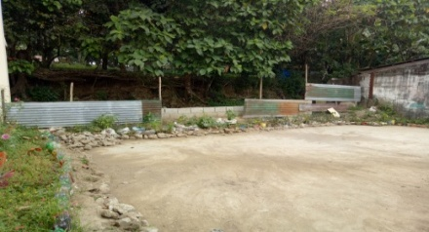
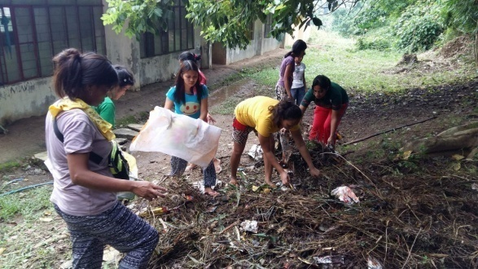
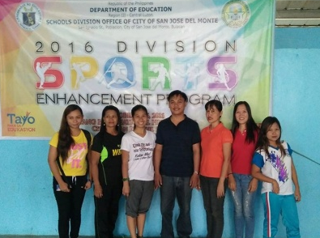
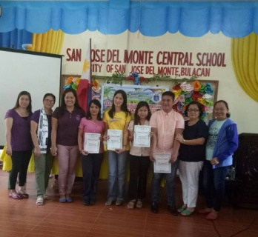
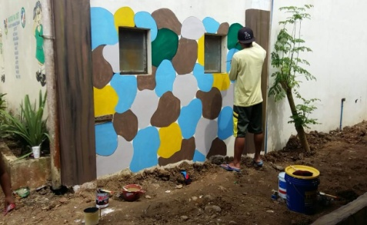
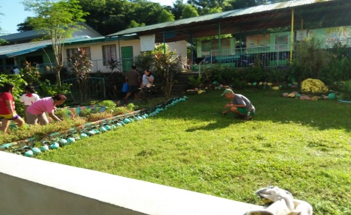
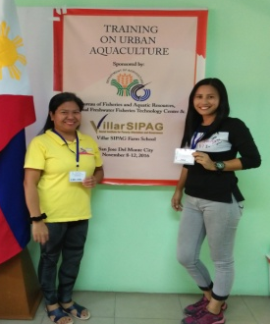
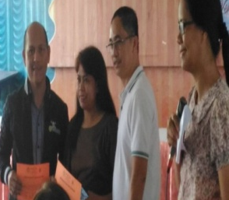
B. OTHER STAKEHOLDERS’ ACCOMPLISHMENTS
D. TEACHERS PROFESSIONAL DEVELOPMENT
Different seminars attended by the teachers during the school year.

Slide 6
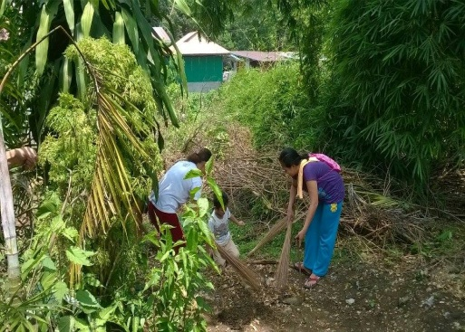
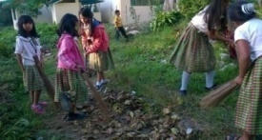
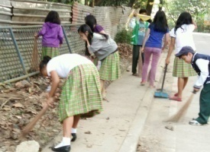
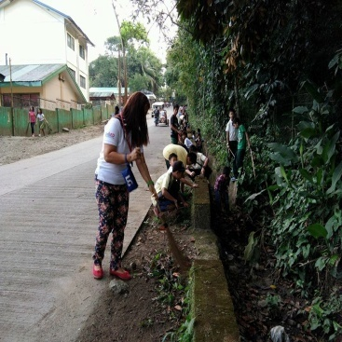
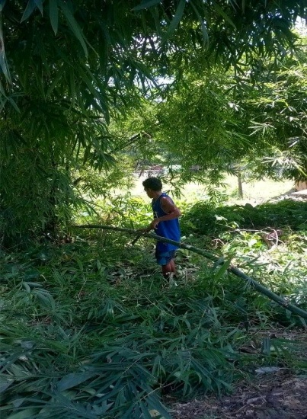
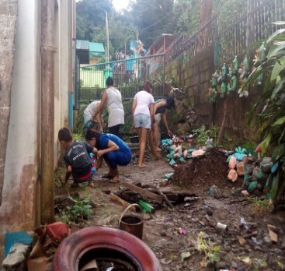
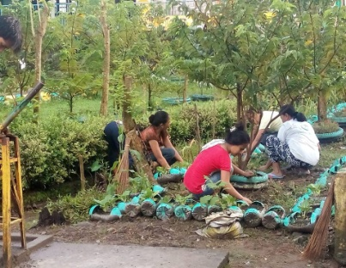
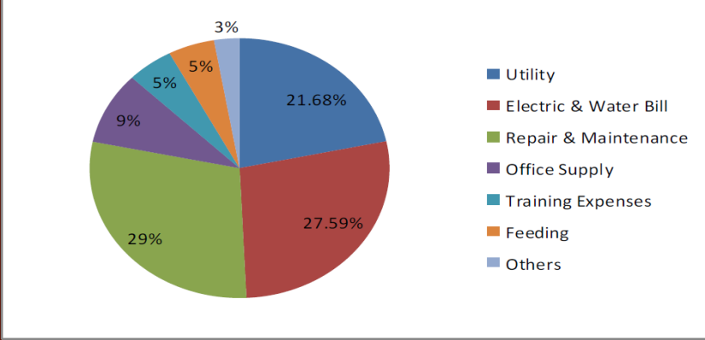
TEACHERS PROFESSIONAL DEVELOPMENT
B. OTHER STAKEHOLDERS’ ACCOMPLISHMENTS
C
L
E
A
N
U
P
Subject Coordinator and other teachers with special coordinatorships have attended seminars in the district and division level. The rest of the teaching force have gained professional development trainings thru SLAC. Moreover, 11 teachers are enrolled in Graduate Studies Program.
E. SCHOOL MOOE AND CANTEEN FUND DISTRIBUTION
Tie up with City Government’s Clean Up Drive and Anti Dengue Project
D R I V E
School expenses is funded through MOOE and Canteen Fund subject to the guidelines in the DepEd Order.

Slide 7
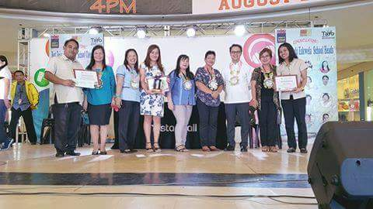
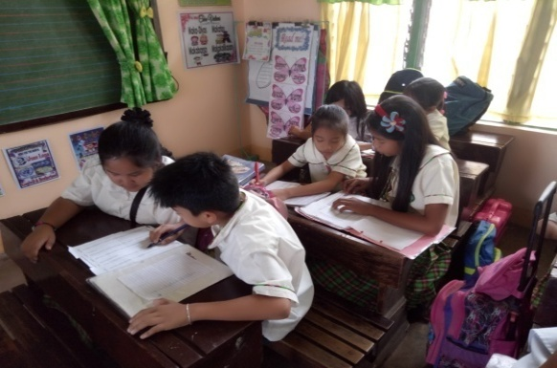
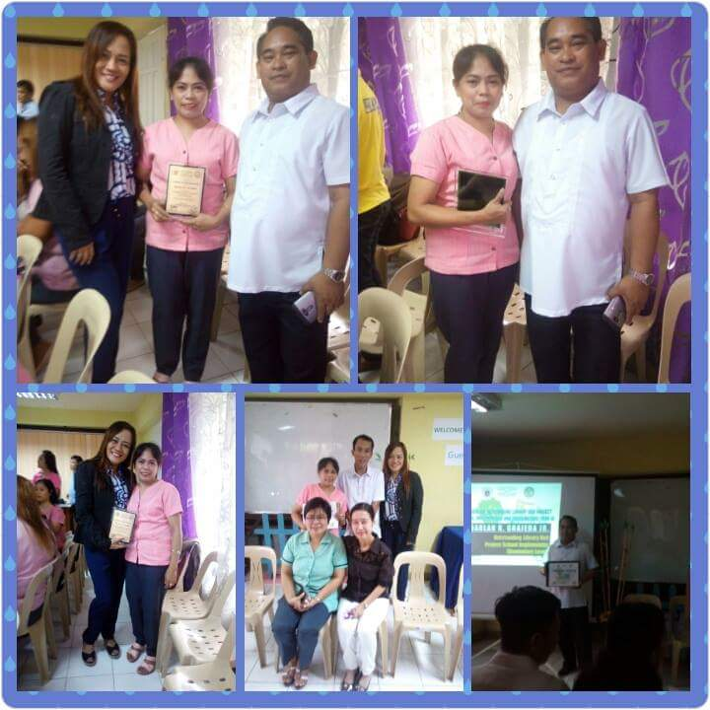
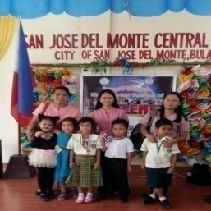
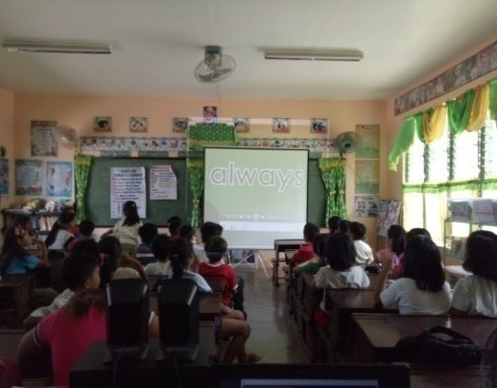
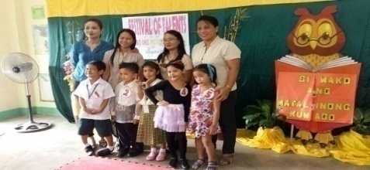
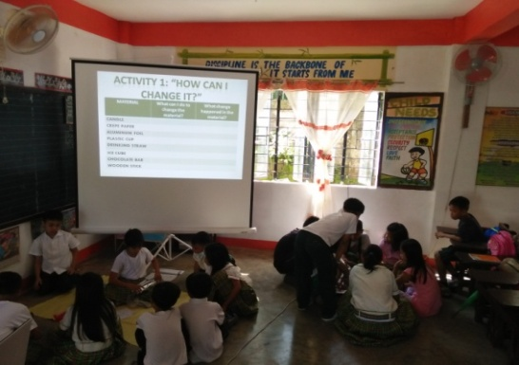
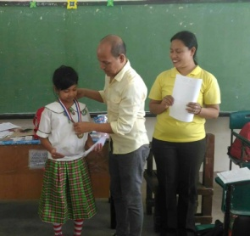
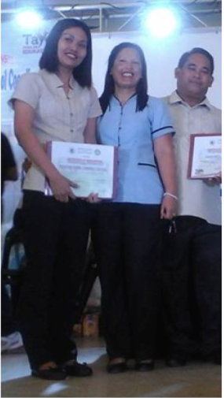
STATUS OF SCHOOL PROJECTS
F. SCHOOL AWARDS AND RECOGNITION
“ACADEMIC ACHIEVERS”
PEER TEACHING
READING INTERVENTION USING MULTIMEDIA
PUPILS HANDS-ON ACTIVITY

Slide 8
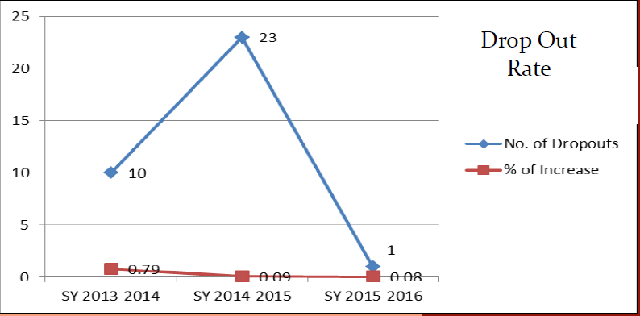
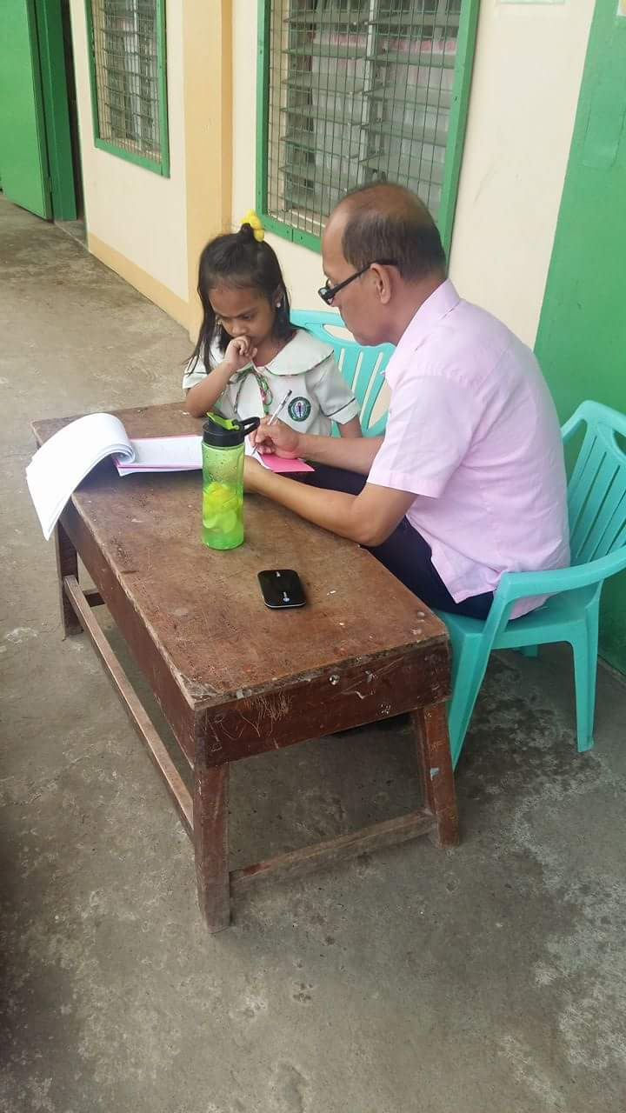
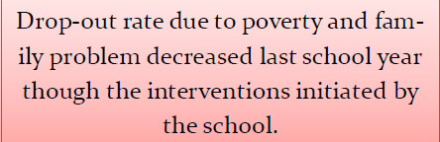
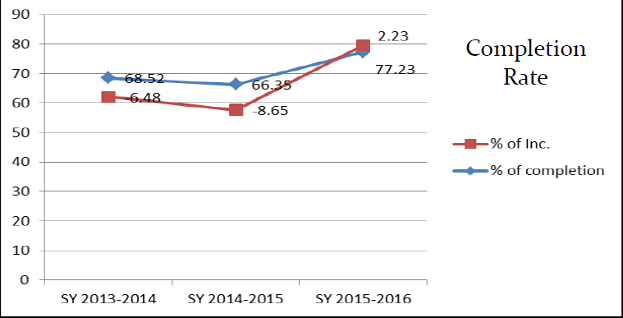
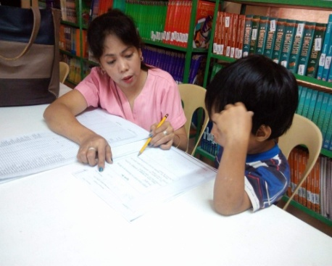
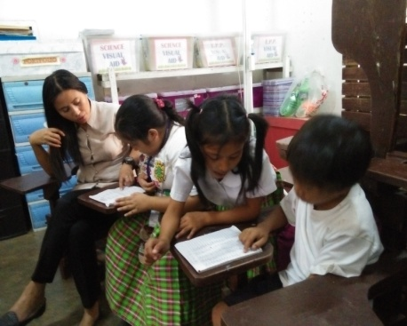
II. PERFORMANCE INDICATOR
STATUS OF SCHOOL PROJECTS
A. ACCESS AND QUALITY
“ACADEMIC ACHIEVERS”
Training of pupils for different contests.
INTERVENTION AND REMEDIATION
Modified Reading Recovery Interventions for different grade levels

Slide 9
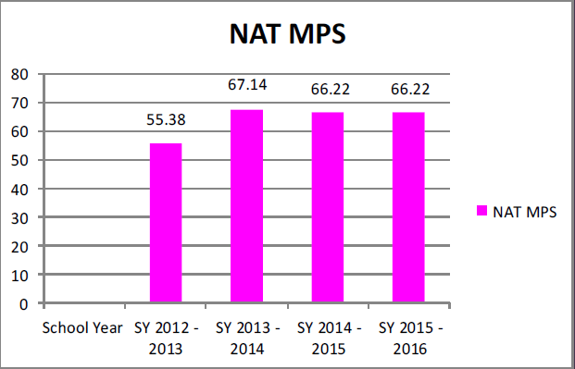
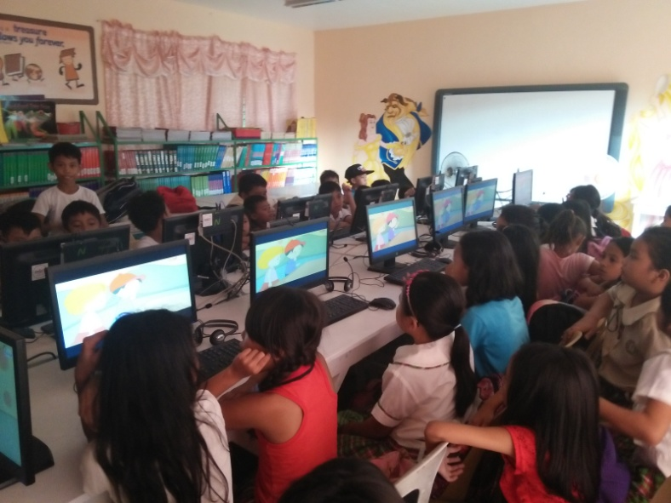
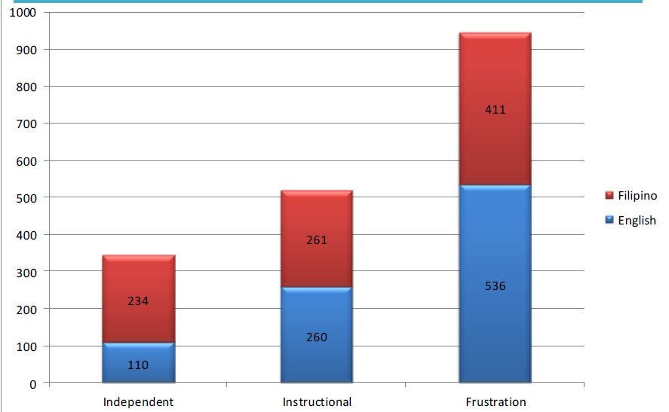
STATUS OF SCHOOL PROJECTS
ACCESS AND QUALITY
NAT RESULT
“KAYA MO KID PROJECT”
LITERACY LEVEL
Combined Science and Math Room where pupils hold sessions. Combined ICT Room/Library is functional as well.

Slide 10
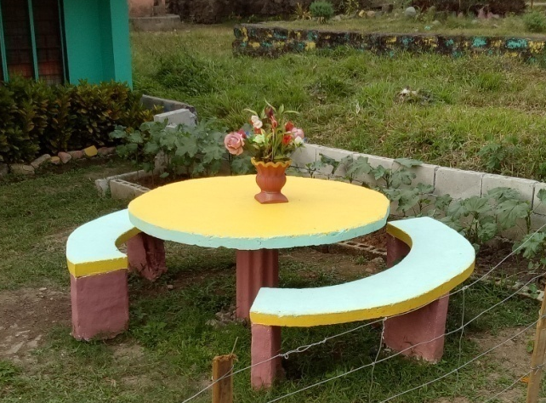
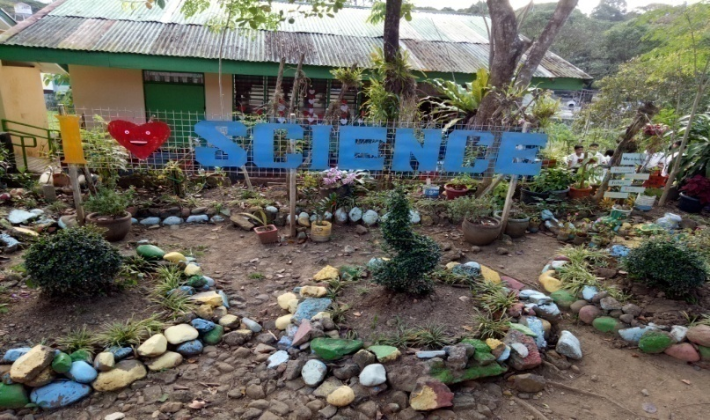
B. GOVERNANCE
STATUS OF SCHOOL PROJECTS
1. SCHOOL BASE MANAGEMENT
“SAGIP KABATAAN PARA SA KINABUKASAN PROJECT”
Study nooks are rehabilitated to make learning more enjoyable for the pupils.
2. CHILD-FRIENDLY SCHOOL SURVEY RESULT
CFSS
93%
QUALITATIVE INTERPRETATION:
OUTSTANDING
The survey result of 93% makes us an outstanding Child Friendly School.
ACADEMIC GARDENS are constructed for a more child-friendly environment.

Slide 11
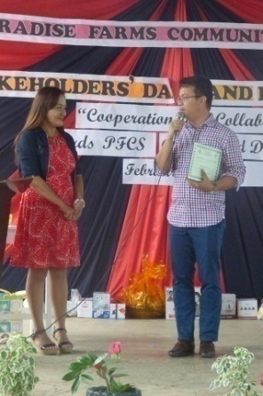
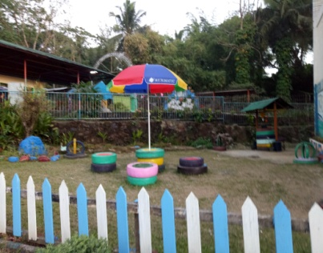
STATUS OF SCHOOL PROJECTS
GOVERNANCE
“SAGIP KABATAAN PARA SA KINABUKASAN PROJECT”
3. STAKEHOLDERS’ PARTICIPATION
More study nooks for the pupils where they can spend time doing their school-related activities.
Saying “Thanks” to the people who served as our partner in achieving the DepEd’s VGMO.

Slide 12
GOVERNANCE
STATUS OF SCHOOL PROJECTS
STAKEHOLDERS’ PARTICIPATION
“EMPOWERED KIDS PROJECT”
ABS-CBN
ANG PROBINSYANO
SAFEGUARD
SCHOOL CARAVAN

Slide 13
STATUS OF SCHOOL PROJECTS
GOVERNANCE
“EQUIPPING THE LEARNERS”
D. LEARNER-TEACHER RATIO
E. LEARNER-CLASSROOM RATIO
1:43 LEARNER-TEACHER RATIO
This figure shows that generally, there are 43 pupils for every teacher.
18 ACADEMIC CLASSROOMS
There are 18 academic classrooms that cater 29 classes from K – 6.
F. LEARNER –TOILET RATIO
G. LEARNER-SEAT RATIO
24 COMMON COMFORT ROOMS
There is sufficient number of toi-lets for the total number of enrollees.
1:1 SEATS RATIO
There is enough seats for the pupils since we are implementing shifting of classes. Teachers have one table each.
INSTRUCTIONAL MATERIALS – Improvised Strategic Instructional Materials are made

Slide 14
III. STATUS OF SCHOOL PROJECTS
STATUS OF SCHOOL PROJECTS
A. STATUS OF ANNUAL IMPROVEMENT PLAN (AIP)/CONTINOUS IMPROVEMENT PROJECTS
“PFCS CARES”
TEACHER’S DEVELOPMENT PROGRAM
PATHWALK
DRAINAGE
“BATA AKO NGAYON, PINUNO BUKAS”
School activities that hone the pupils’ leadership skills; scouting, SPG, Young Farmers Club, YES-O and others.
SLAC sessions are held according to the topics listed on the approved Annual LAC Plan.

